Slide 1

Pathway System Management
Version 1.0

Slide 2
Introduction

Slide 3
Pathway architecture - Introduction
A transaction processing system
A powerful and versatile OLTP monitor
Provides programs and environment to support OLTP on Tandem system
Supports Requester-Server approach
Includes NonStop TS/MP and Pathway/TS products

Slide 4
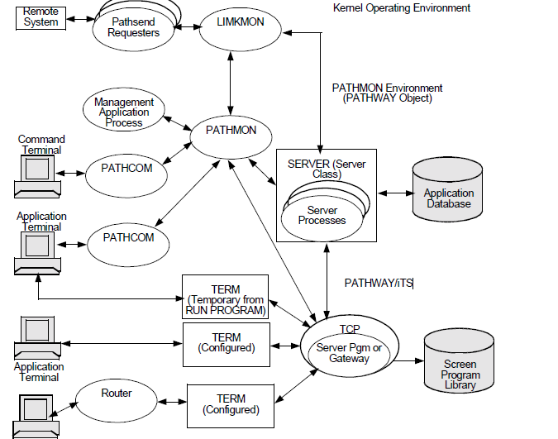
PATHWAY ENVIRONMENT

Slide 5
Components of Pathway
PATHMON
PATHCOM
TCP
SCREEN COBOL LIBRARY
TERM and PROGRAM
SERVER CLASS
SERVER PROCESS
LINKMON

Slide 6
Components of Pathway Cont.
Additional components in Guardian environment that support OLTP when used with the Pathway:
    PATHSEND Requester
    Remote Server Call (RSC)
    Transaction Delivery Process (TDP)
    Extended General Device Support (GDSX)
    Intelligent Device Support (IDS)

Slide 7
PATHMON
It is the supervising process that manages all other processes running in the Pathway system.
It provides the process management function, which includes starting, stopping and monitoring the processes of OLTP.

Slide 8
PATHCOM
  An interactive interface to PATHMON process
  Provides a set of commands for defining and managing the Pathway environment
    Configures server objects
    Starts and stops server objects
    Obtain status information
    Request performance statistics

Slide 9
TERMINAL CONTROL PROCESS (TCP)
  Executes the SCREEN COBOL programs in your application
  Coordinates communication between screen program, input-output devices or processes, server programs, and the PATHMON process

Slide 10
TCP Cont.
Features provided by TCP:
  Fault tolerance
  Automatic retry of I/O operations
  Transaction protection
  Multithreading
  Interpretation of pseudocodes of requesters
  Access to servers
  Unsolicited message processing support

Slide 11
SCREEN COBOL LIBRARY
  The SCREEN COBOL compiler compiles the SCREEN COBOL requester programs and generates pseudo-object files (POBJDIR, POBJCOD, and POBJSYM).
  These pseudocodes are interpreted and executed by the TCP.

Slide 12
TERM and PROGRAM
  It represents the task controlling INPUT/OUTPUT devices and processes that allow the users to interact with Pathway application.
  Temporary TERM objects are called PROGRAM objects.

Slide 13
SERVER PROCESS
  Server process is a running database management program that handles the inter-process communication messages for one or more services.
  It is a Guardian process and can run NonStop as a paired process.

Slide 14
SERVER PROCESS Cont.
Benefits of Server Processes:
  Ensure transaction integrity, thereby database integrity
  Server code reusable by many requesters
  Control over transactions
  High performance in distributed environment

Slide 15
SERVER CLASS
A group of identical server processes created from the same object file on the disk is called a server class .
A server class is, therefore, a group of server processes that perform a specific type of application work.

Slide 16
SERVER CLASS Cont.
Benefits of Server Classes:
  Minimal use of system resources
  Performance can be maximized
  Dynamic control over server processes
  On-line changes for load balancing to suit response-time requirements

Slide 17
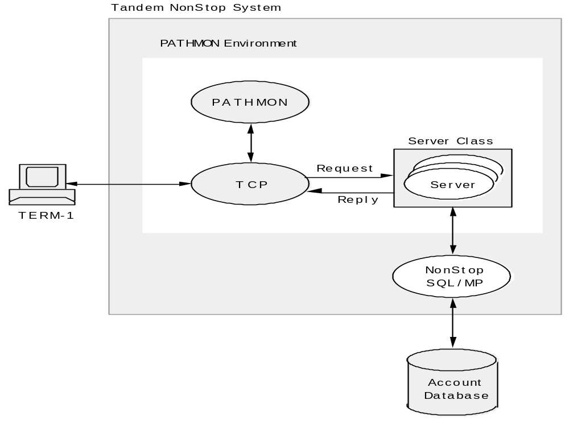

Slide 18
PATHCTL and LOG FILES
PATHCTL
    It is a disk file in which the PATHMON process maintains the configuration information about the objects under its control
LOG FILES
    A PATHMON process uses log files for reporting the errors and changes in the status

Slide 19
Components of Pathway Cont.
LINKMON
    It is the process which manages the communication between the server processes and the PATHSEND processes
PATHSEND
    The PATHSEND processes are user applications that use PATHSEND procedure calls, rather than SCREEN COBOL SEND statement, to send requests to server classes

Slide 20
Components of Pathway Cont.
REMOTE SERVER CALL (RSC)
    Enables client-server computing by supporting a variety of hardware and software configurations and communication protocols for PCs and workstations
TRANSACTION DELEVERY PROCESS (TDP)
    A multithreaded gateway process that manages multiple connections from workstation based clients

Slide 21
Components of Pathway Cont.
INTELLIGENT DEVICE SUPPORT (IDS)
  A feature of the TCP that supports access to Pathway server classes by intelligent devices
  Facilitates SCREEN COBOL requester programs to interact with external processes that, in turn, communicate with devices such as PCs, automated teller machines, and point-of-sale devices

Slide 22
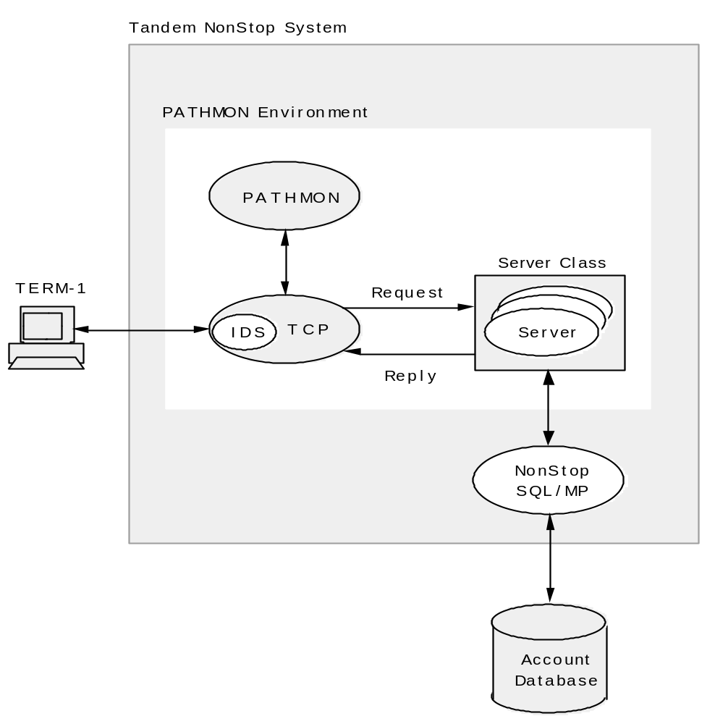

Slide 23
PATHSEND Environment
The PATHSEND environment consists of PATHSEND requester process and LINKMON process.
PATHSEND requester programs are coded in languages other than SCREEN COBOL.
LINKMON process manages the communication between the PATHSEND processes and the server processes.

Slide 24
Properties of LINKMON
LINKMON Tasks
Communication with PATHMON environment
Execution
Process name

Slide 25
Properties of LINKMON Cont.
Initialization
Limits
Extended Memory
CPU Halt codes

Slide 26
PATHSEND Management Tasks
Specifications for setting up PATHSEND environment:
Maximum number of LINKMON processes that can be supported at a time
Security to control access to server class
  Network level security
  Server class security

Slide 27
Monitoring LINKMON Process
Check values of the LINKMON
Display information about LINKMON process
Display statistics for server classes to which the LINKMON process has links

Slide 28
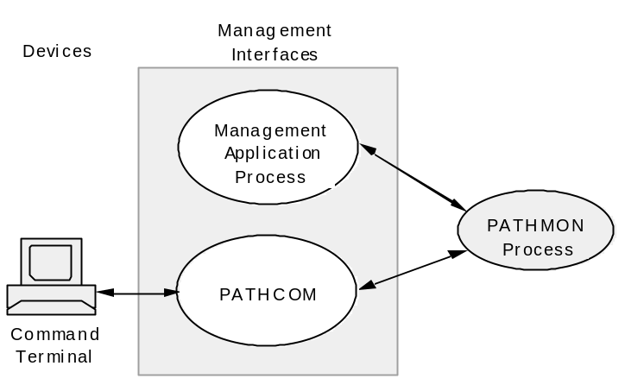
Management Interface

Slide 29
SPI Definition Files
Token based interface
Need of declaring tokens
Standard tokens stored in definition files
Pathway definition files

Slide 30
Pathway Configuration and Operation
Involves SYSTEM MANAGEMENT TASKS such
as:
Start PATHWAY environment
Configure and start PATHMON environment
Configure PATHMON controlled objects
Start PATHMON controlled objects
Stop PATHMON controlled objects

Slide 31
Start PATHWAY environment
Start PATHMON process
Start PATHCOM process
First step in starting a PATHWAY system is to start
a PATHMON - the Pathway monitoring process.
Then PATHCOM can be started optionally.

Slide 32
Start PATHMON environment
Starting a PATHMON environment involves
following steps:
Start the PATHMON process
Start the PATHCOM process
Configure the PATHMON environment
Start the configured objects

Slide 33
Starting PATHMON
A PATHMON process can be started with a simple
command on TACL prompt:
> PATHMON / NAME $xxxx, CPU n, NOWAIT, OUT xyz /

Slide 34
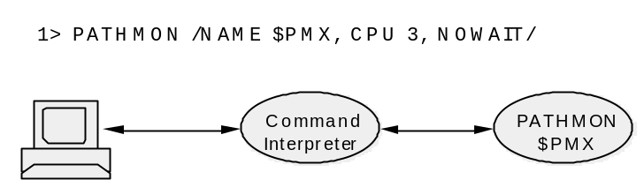
Starting PATHMON

Slide 35
Starting PATHCOM
After starting the PATHMON process, following
command at the TACL prompt can be used to start
the PATHCOM process:
> PATHCOM $xxxx
This command will start a PATHCOM process that
will communicate with the $xxxx PATHMON
process.

Slide 36
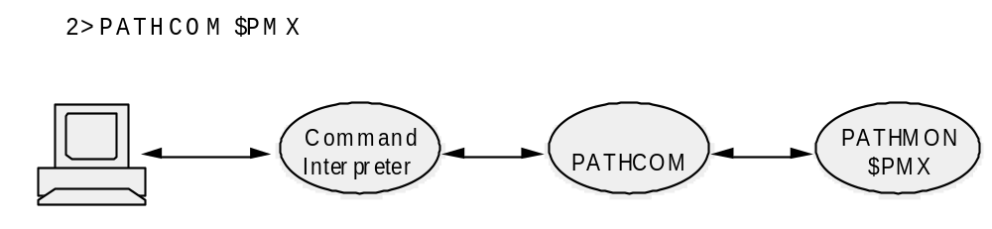
Starting PATHCOM

Slide 37
Starting PATHCOM Cont.
The operator can also start a PATHCOM process
to communicate with a PATHMON process running
on another node by using fully qualified PATHMON
process name as follows:
> PATHCOM \node.$xxxx

Slide 38
Starting PATHCOM Cont.
More commands can be used to configure a
Pathway subsystem. These are:
IN command
OBEY command
TACL Routine
Using DEFINEs

Slide 39
IN Command
> PATHCOM / IN $volme.subvolume.config, OUT $S.#list, CPU 2, NOWAIT / $xxxx
The PATHCOM commands are read from the
Pathway configuration file config, and listed in
$S.#list device.

Slide 40
OBEY Command
> PATHCOM $xxxx
Now, a “=“ sign appears in place of TACL prompt,
at which type following command:
= OBEY $volume.subvolume.config
Commands from config file will now be read and
executed.

Slide 41
Using DEFINEs
The operator can use DEFINEs to specify file
names that PATHCOM uses directly as commands
> ADD DEFINE =OBEY-FILE, CLASS MAP, FILE $vol.subvol.obeyfile
> PATHCOM / IN =OBEY-FILE / $vol.subvol.config
In this case PATHCOM commands are taken from
the =OBEY-FILE ($vol.subvol.obeyfile)

Slide 42
Global Parameters
The global parameters are to be set using the SET
PATHWAY command, which specifies the
maximum limit of overall configuration.
For example: SET PATHWAY MAXTCPS 10
means that a maximum of 10 TCPs can be added
to the PATHMON configuration file.

Slide 43
Global Parameters Cont.
MAXASSIGNS
  Maximum number of Assign definitions that can be
  specified for all server classes.
MAXPARAMS
  Maximum number of PARAM messages that can be
  specified across all server classes.
MAXDEFINES
  Maximum number of DEFINEs that can be specified
  for objects.

Slide 44
Global Parameters Cont.
MAXSERVERCLASSES
  Maximum number of server classes that can be
  added to the PAHMON configuration.
MAXSERVERPROCESSES
  Maximum number of server processes that can be
  added to the PATHMON configuration and started.

Slide 45
Global Parameters Cont.
MAXLINKMONS
  Maximum number of LINKMONs that the PATHMON
  can handle.
MAXPROGRAMS
  Maximum number of PROGRAM objects that can be
  added. Limit is 4095.

Slide 46
Global Parameters Cont.
MAXTERMS
  Maximum number of TERMs that can be added to
  the PATHMON configuration file. The maximum limit
  is 4095.
MAXEXTERNALTCPS
  Maximum number of external TCPs that can
  communicate with the PATHMON process at the
  same time.

Slide 47
Global Parameters Cont.
MAXTELLQUEUE
  Maximum number of TELL messages that can be
  queued for each terminal. Varies from 0 through
  4095.
MAXTELLS
  Maximum number of TELL messages that can exist
  concurrently in a PATHMON environment. Default
  value is 32.

Slide 48
Global Parameters Cont.
MAXPATHWAY
  Maximum number of external Pathway systems to
  which communication is required.
MAXTMFRESTARTS
  Maximum number of times a TCP attempts to restart
  a logical TMF transaction after the transaction aborts
  and before the SEND error occurs.

Slide 49
Global Parameters Cont.
MAXSTARTUPS
  Maximum number of server classes that can have
  startup messages.
MAXTPATHCOMS
  Maximum number of PATHCOM processes that can
  run simultaneously within a PATHMON environment.

Slide 50
Global Parameters Cont.
The parameters listed below specify the owner and
security attributes for the Pathway system:
SET PATHWAY OWNER 240,207
SET PATHWAY SECURITY “NUNU”

Slide 51
Global Parameters Cont.
SET PATHWAY NODEINDEPENDENT ON/OFF
This attribute makes unspecified node names for
processes and devices default to the node where
PATHMON process is running. This helps in
shifting the PATHMON application to another
node.

Slide 52
Types of starting PATHMON environment
COLD start
Operator can use this option when
  Starting a new PATHMON environment, which creates new PATHCTL file.
  Changed the OWNER, SECURITY, or the NODEINDEPENDENT attribute.
  Modified the system limits using the SET PATHWAY command.

Slide 53
Types of starting PATHMON environment Cont.
COOL start
Operator can use this option for restarting the
PATHMON environment.

Slide 54
Shutting down PATHMON environment
The whole PATHMON environment can be shut
down collectively using SHUTDOWN2 command.
Following actions occur at this command:
  All TCP objects begin shutdown.
  New work is disallowed.
  The PATHMON process logs the start and completion of SHUTDOWN2; it does not log status messages during shutdown.

Slide 55
Modes of shutting down
Three modes of shutting down a PATHMON
environment:
ORDERLY
  =SHUTDOWN2, MODE ORDERLY
ABORT
  =SHUTDOWN2, MODE ABORT
IMMEDIATE
  =SHUTDOWN2, MODE IMMEDIATE

Slide 56
General PATHCOM Commands
ADD
  Enters the description of the object into the
  configuration. Eg,
  ADD SERVER ECHO-SERVER
ALTER
  Changes the attributes of the previously defined
  object while the object is stopped.

Slide 57
General PATHCOM Commands Cont.
CMDCWD
  Sets the default absolute OSS directory for
  expansion of any OSS process file names.
CMDVOL
  Sets the default volumes and subvolumes for
  expansion of any Guardian process file names,
  except OBEY file names.

Slide 58
General PATHCOM Commands Cont.
CONTROL
  Changes the attributes of the Pathway while it is
  running. Used for PATHMON process only.
DELETE
  Removes the object definition from the PATHMON
  configuration file.

Slide 59
General PATHCOM Commands Cont.
ERROR
  Enables PATHCOM to continue executing
  commands after encountering a specified number
  of errors.
EXIT
  Stops the PATHCOM.
FC
  Repeat the last command.

Slide 60
General PATHCOM Commands Cont.
FREEZE
  Prohibits communication between terminal and
  server class.
HELP
  Help is available for the syntax of the command.
INFO
  Displays the values of the attributes

Slide 61
General PATHCOM Commands Cont.
LOG1 and LOG2
  Specifies the log files for the PATHMON process
  to report the errors and changes in the status.
OBEY
  Causes to read from the file.
OBEYVOL
  Sets the default volume and subvolume for
  expansion of command file names.

Slide 62
General PATHCOM Commands Cont.
OPEN
  Specifies the name of the PATHMON process to
  which PATHCOM commands are directed.
PRIMARY
  Causes Primary and the Backup processes to
  resume executing in CPUs defined in the
  configuration file.

Slide 63
General PATHCOM Commands Cont.
RESET
  Resets the attributes of the objects to the default
  values. Eg,
  RESET TCP MYTCP
SET
  Establishes values for object attributes prior to
  adding an object to the Pathway environment.

Slide 64
General PATHCOM Commands Cont.
SHOW
  Displays current attributes of the objects and
  environmental settings for PATHMON.
START
  Starts one or more configured objects. Eg,
  START TCP MYTCP
  START TERM *

Slide 65
General PATHCOM Commands Cont.
STATS
  Displays resource usage and system performance
  statistics. Eg,
  STATS SERVER MYSERV
  Use the STATS SERVER command to display
  resource usage and performance statistics, including
  response time information. These statistics provide
  information about server class operations; they are
  tracked by LINKMON processes and the TCPs that
  have links to a server class.

Slide 66
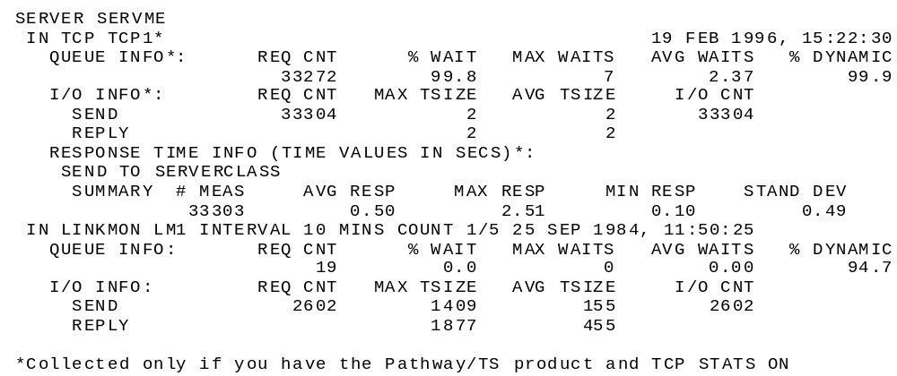
STATS SERVER Example

Slide 67
General PATHCOM Commands Cont.
STATUS
  Displays the current status of any PATHMON
  controlled object or LINKMON process linked to a
  server class. The commands are:
  STATUS PATHWAY
  STATUS PATHMON
  STATUS LINKMON
  STATUS SERVER

Slide 68
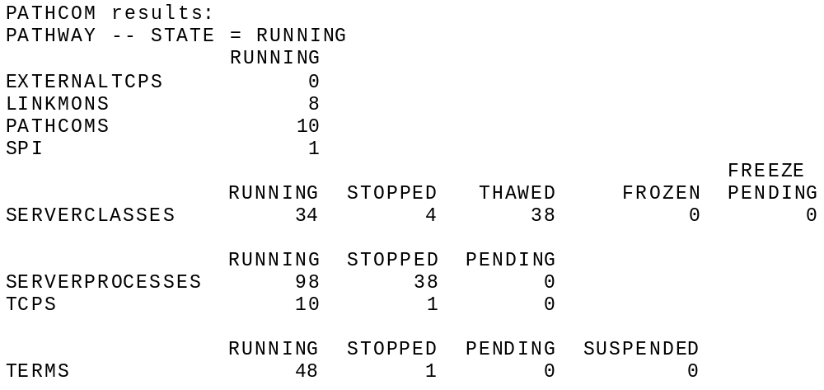
STATUS PATHWAY Display

Slide 69
General PATHCOM Commands Cont.
STOP
  Stops all the PATHMON controlled objects.
SWITCH
  Causes the Primary and Backup processes to
  exchange functions.
THAW
  Removes the prohibition imposed by using FREEZE
  command on a server class.

Slide 70
QUIZ
Identify the major components of the Pathway environment.
What is a server class? Why is it used in a Pathway system?
When does PATHMON create the Pathway control file PATHCTL?
How are TCPs started and stopped? How about servers?

Slide 71
QUIZ Cont.
Can we start a terminal before a TCP is defined and added? How about a server? Why or why not?
What Pathway feature is designed to handle peak transaction periods? What are the pros and cons of this technique?
What is a Pathway PROGRAM entity?
  What happens when a RUN PROGRAM command is executed by PATHMON?
  Would you normally use a PROGRAM entity for end users?

Slide 72


THANK
YOU!

